Slide 1

Case Study 6
MODEL TUNING- REWIND.
Nafis Zafar

Slide 2
Objectives:
EDA (Exploratory Data Analysis
Data pre-processing: Missing value treatment, prevent data leakage
Model Building - Build at least 6 classification models (Using logistic regression, decision trees, random forest, bagging classifier and boosting methods)
Model Building with Oversampled data and Undersampled data
Hyperparameter Tuning, productionize model
Business Insights and Recommendation

Slide 3
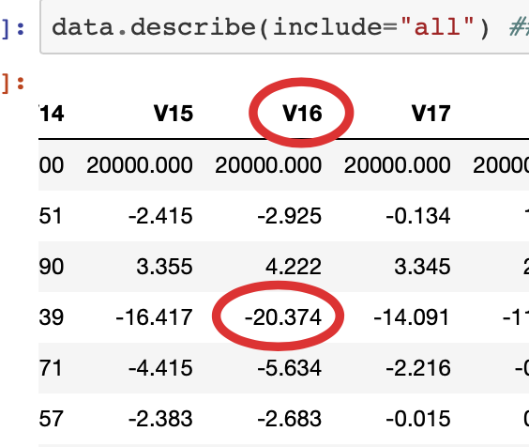
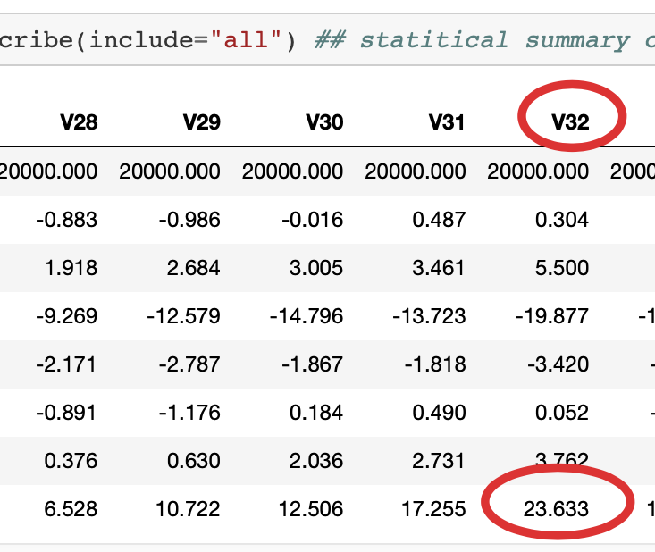
EDA (Exploratory Data Analysis)
There are 20k records in Train dataset and 5k records in Test dataset
There are 41 numerical columns in both datasets
There are no duplicates in both dataset
There are missing values in train and test data
Mean value of the independent variables (v1 to v40) ranges from -2.9 to 2.35
V16 has lowest value of -20.3 and v32 has the highest value 23.6

Slide 4
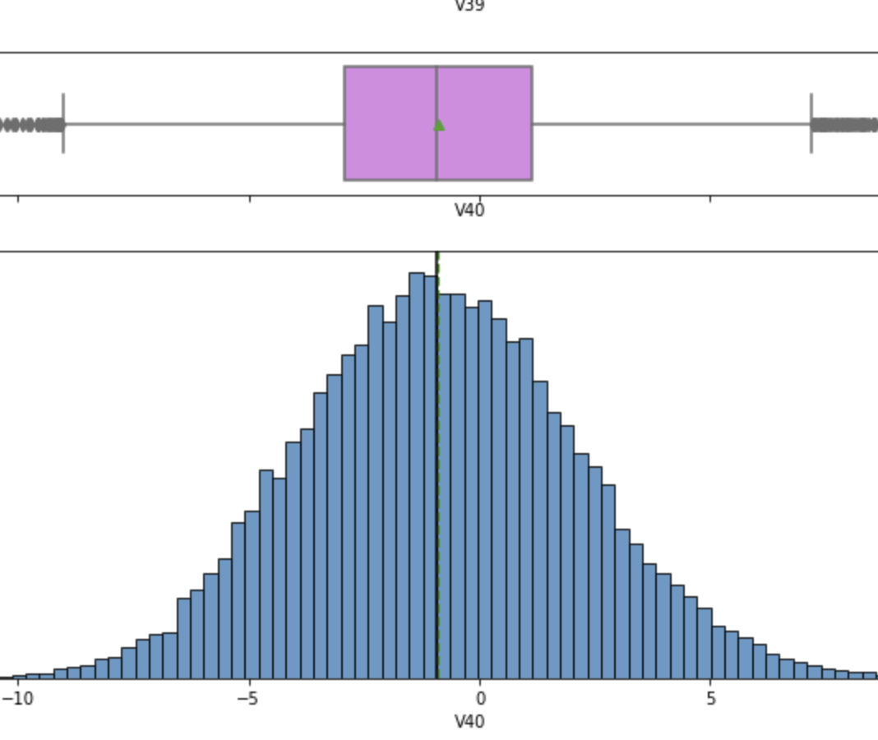
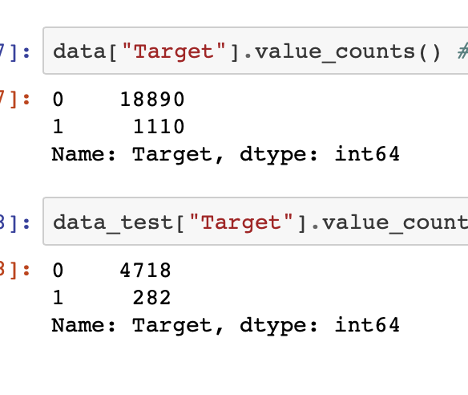
EDA (Exploratory Data Analysis)
Histogram boxplot of v40 shown in SC.
Train dataset has apx 19k count of 0’s and 1110 counts of 1’s
Test dataset has 4,718 count of 0’s and 282 count of 1’s

Slide 5
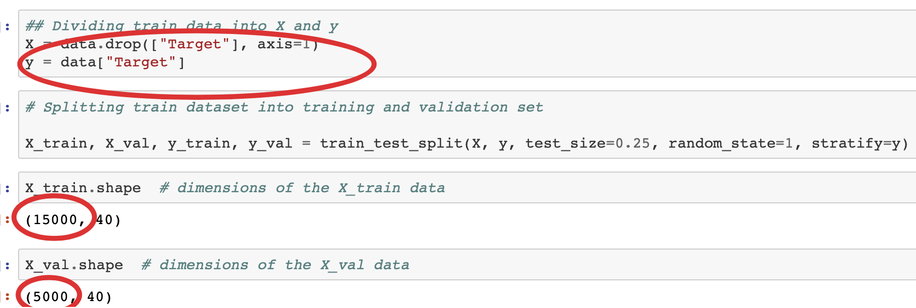
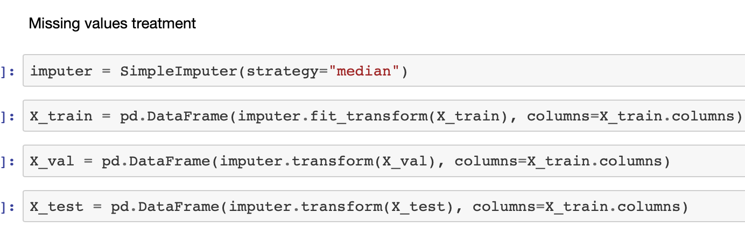
Data pre-processing: Missing value treatment, prevent data leakage
We separated train data into X and Y, Y having the ‘Target’ column.
Then we split the dataset into train and validation
Train dataset has 15k rows and validation has 5k rows
We used ‘median’ for imputing missing values for train, validation and test dataset for X datapoints

Slide 6
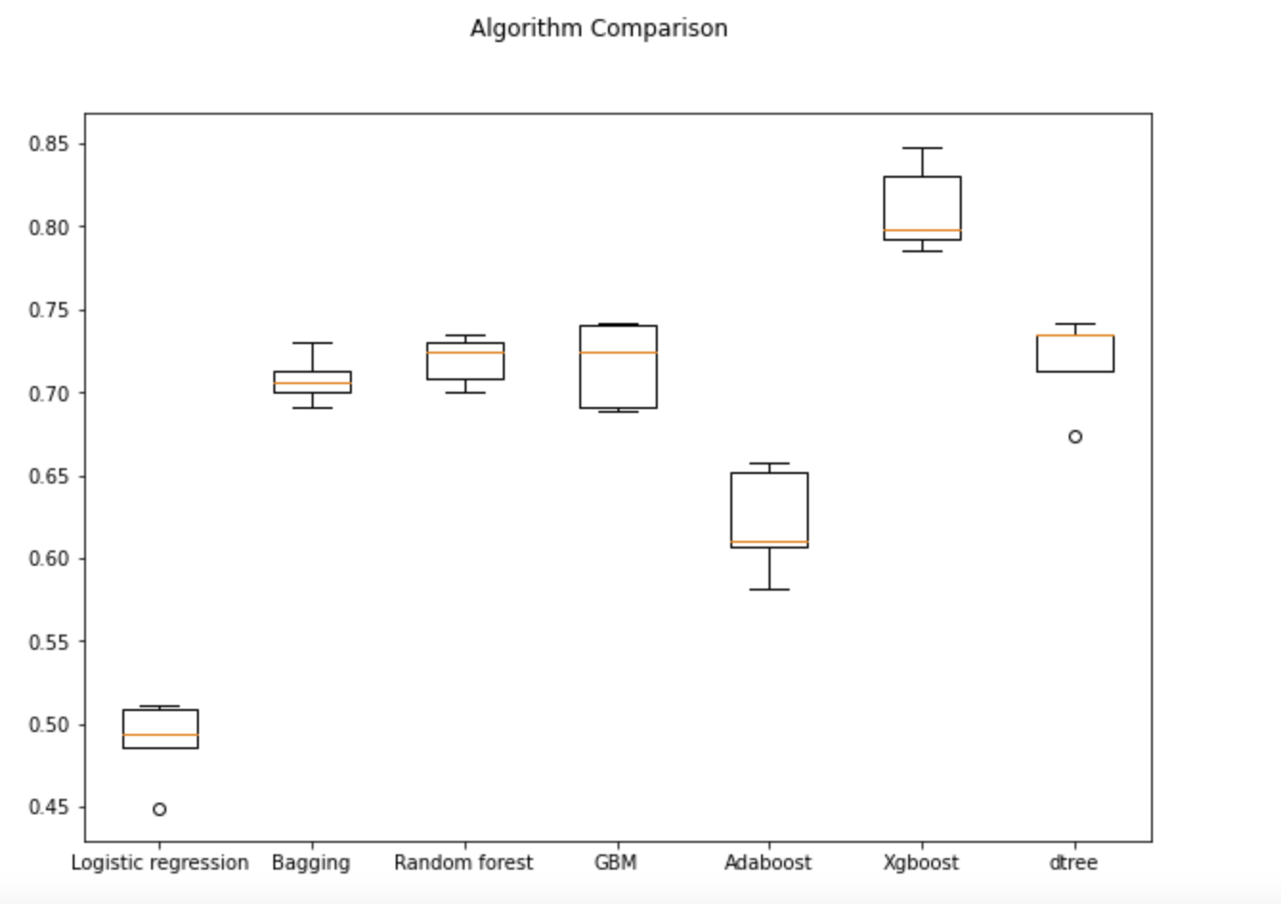
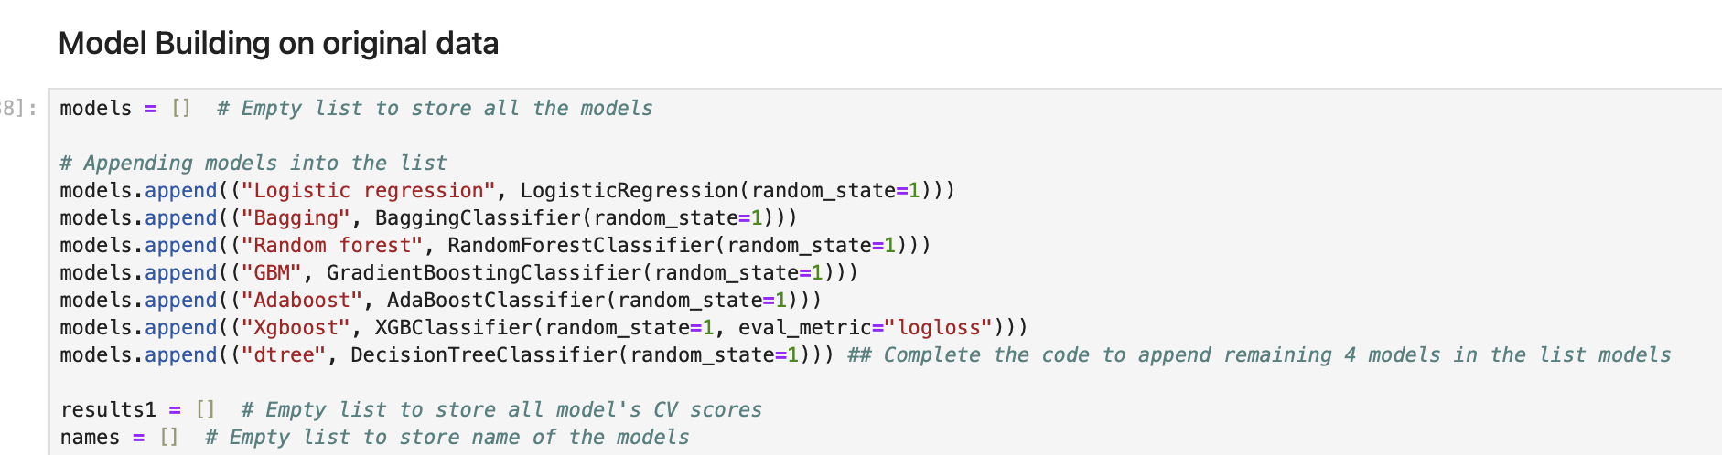
Model Building - Build at least 6 classification models
We are building six ML models with original data : Logistic Regression, Bagging, Random Forest, Gradient Boosting, Ada Boosting and Decision Tree.
Here is the comparison on training dataset

Slide 7
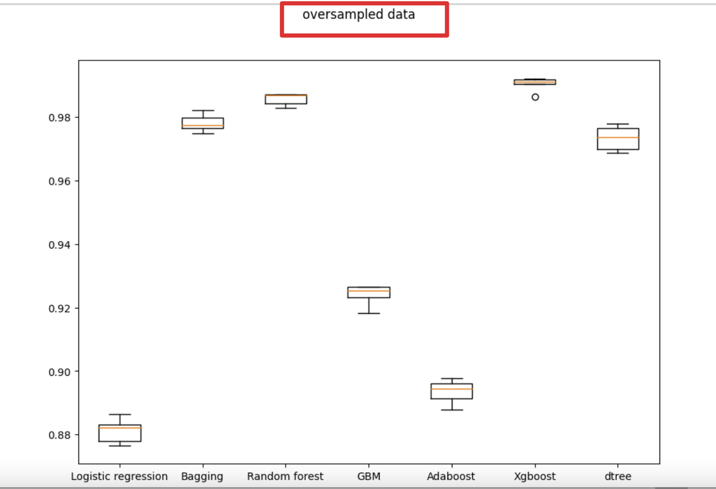
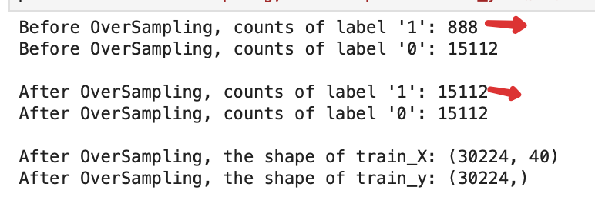
Model Building with oversampled and undersampled data
We are building a model with oversampled data using SMOTE with sampling_strategy=1, k_neighbors=5, random_state=1
After oversampling the 1 counts jumped from 888 to 15112
Here is the performance of models with oversampled data

Slide 8
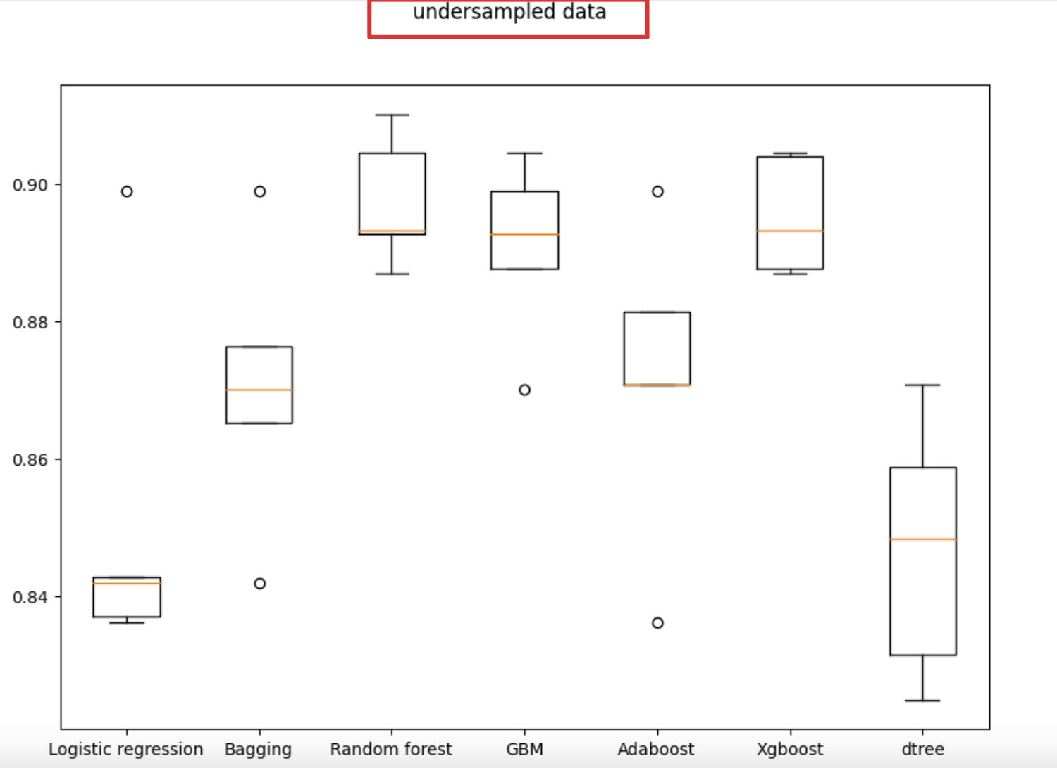
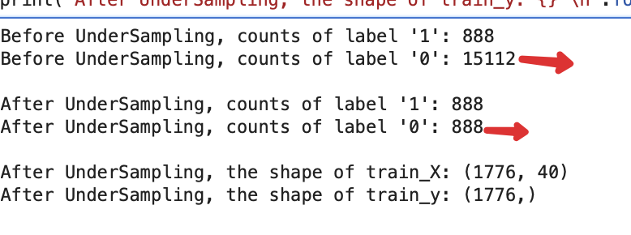
Model Building with oversampled and undersampled data (cont..)
We are building a model with under sampled data using RandomUnderSampler with sampling_strategy=1, random_state=1
After undersampling the 0 label counts went down from 15112 to 888
Here is the performance of models with oversampled data

Slide 9
Hyperparameter Tuning and Productionise Model
We tuned AdaBoost with oversampled data. F1 score on validation set was .83 and on training set it was .98
We tuned Random Forest with undersampled data. F1 score on validation set was .59 and on training set it was .96
We tuned Gradiant Boosting with oversampled data. F1 score on validation set was .74 and on training set it was .99
We tuned XGBoost with oversampled data. F1 score on validation set was .82 and on training set it was .99
Please see next slide for comparison of model on training set and validation set

Slide 10
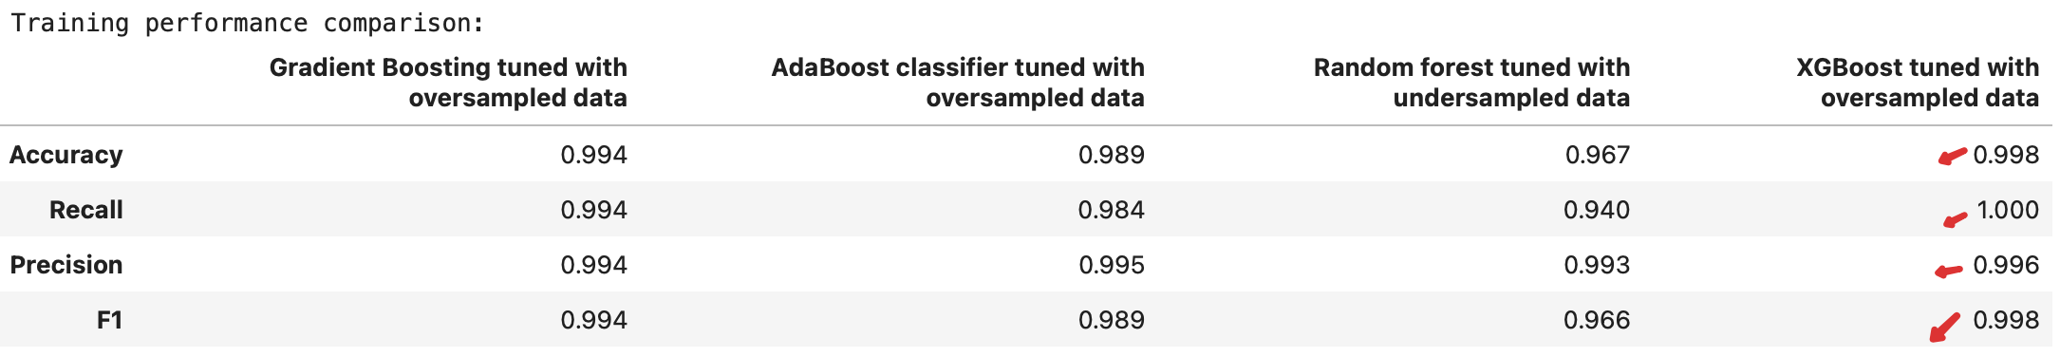
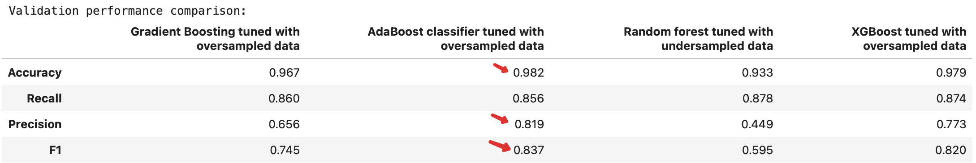
Hyperparameter Tuning and Productionise Model
Here is the comparison of model on training set and validation set
Getting good scores from XGB on training set
But getting better scores from AdaBoost tuned w oversampled data in Validation dataset

Slide 11
Business Insights and Recommendation
AdaBoost Classifier with oversampled data is the model I would recommend overall. Because it performs best on validation dataset.

